Slide 1
A New Method of Analysis & Visualisation over
The Cognitive Real/Virtual SPACE-TIME Using Correlation Function
ICSV22 (#734)
Koji Sato, Ken Ito, Akinori Takei and Toru Toyoda, Division of Composition and Conducting, Interfaculty Initiative in Information Studies, The University of Tokyo

Slide 2
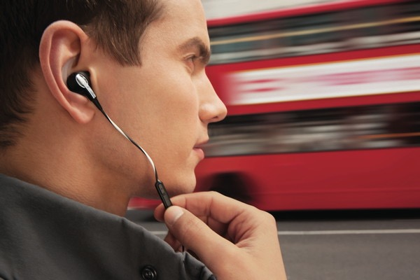
Binaural Headphones
And their risks.
http://wired.jp/2010/09/17/ボーズ、新構造イヤーチップ採用のiphone用ヘッドセ/

Slide 3
Fatal Usages of Binaural Headphones
in ambulation etc. on streets
http://www.amazon.co.jp/gp/feature.html?ie=UTF8&docId=3077752526

Slide 4
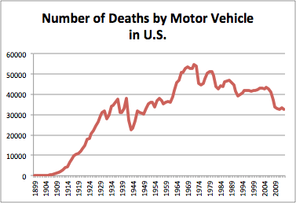
In 2013 success in reducing road fatalities in U.S., ……
Graph is made according to http://www.saferoads.org/federal/2004/TrafficFatalities1899-2003.pdf and etc.

Slide 5

Why road fatalities was relatively modest?
Improving traffic conditions
Improving car safety functions
Improving traffic manners amongst drivers
But most critical point would be NEW REGULATIONS to prohibit driving with headset.

Slide 6
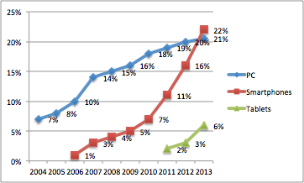
The possession rate of Smartphones is skyrocketing and going over the PCs in 2013 (in estimation)
Global Device Penetration Per Capita
http://www.businessinsider.com.au/smartphone-and-tablet-penetration-2013-10

Slide 7
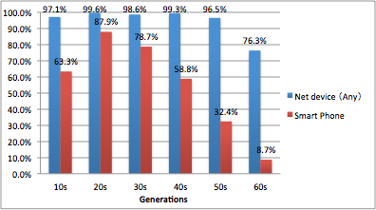
Net Device possession rates in Japan (2013)
Joint research by Institute for Information and Communications Policy (Japan), and Hashimoto Lab., Interfaculty Initiative in Information Studies, The University of Tokyo (2013)

Slide 8
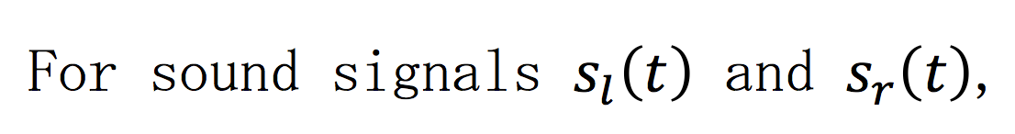
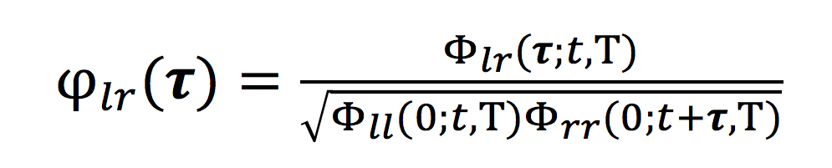
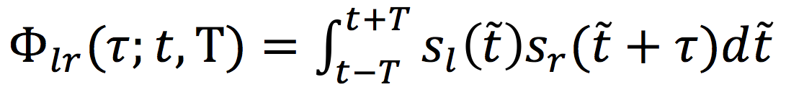
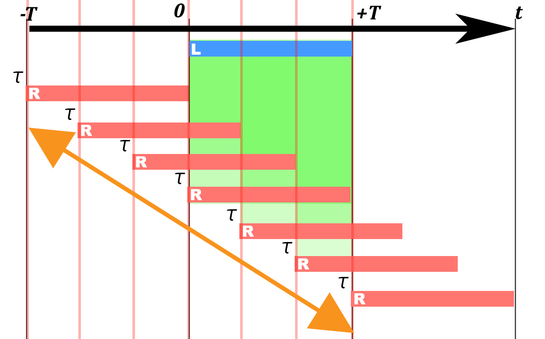
Inter-Channel Crosscorrelation Function
where

Slide 9
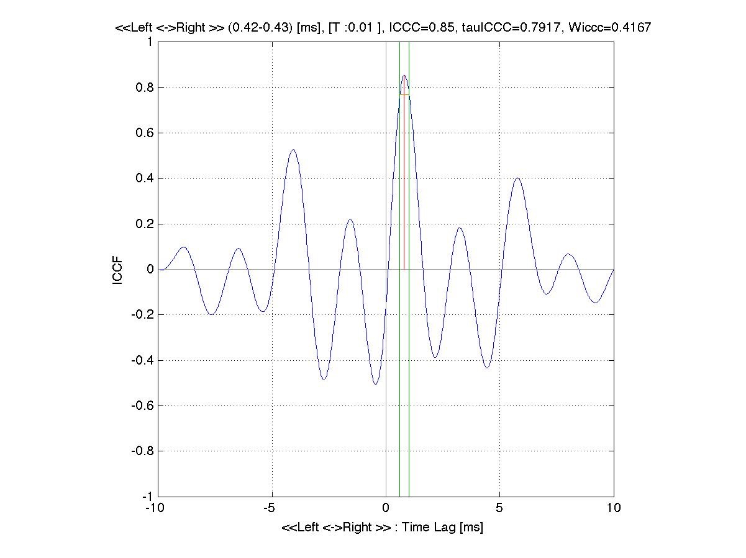
Inter-Channel Crosscorrelation Function
Left
Right
ICCF (#)
Time Lag (sec)

Slide 10
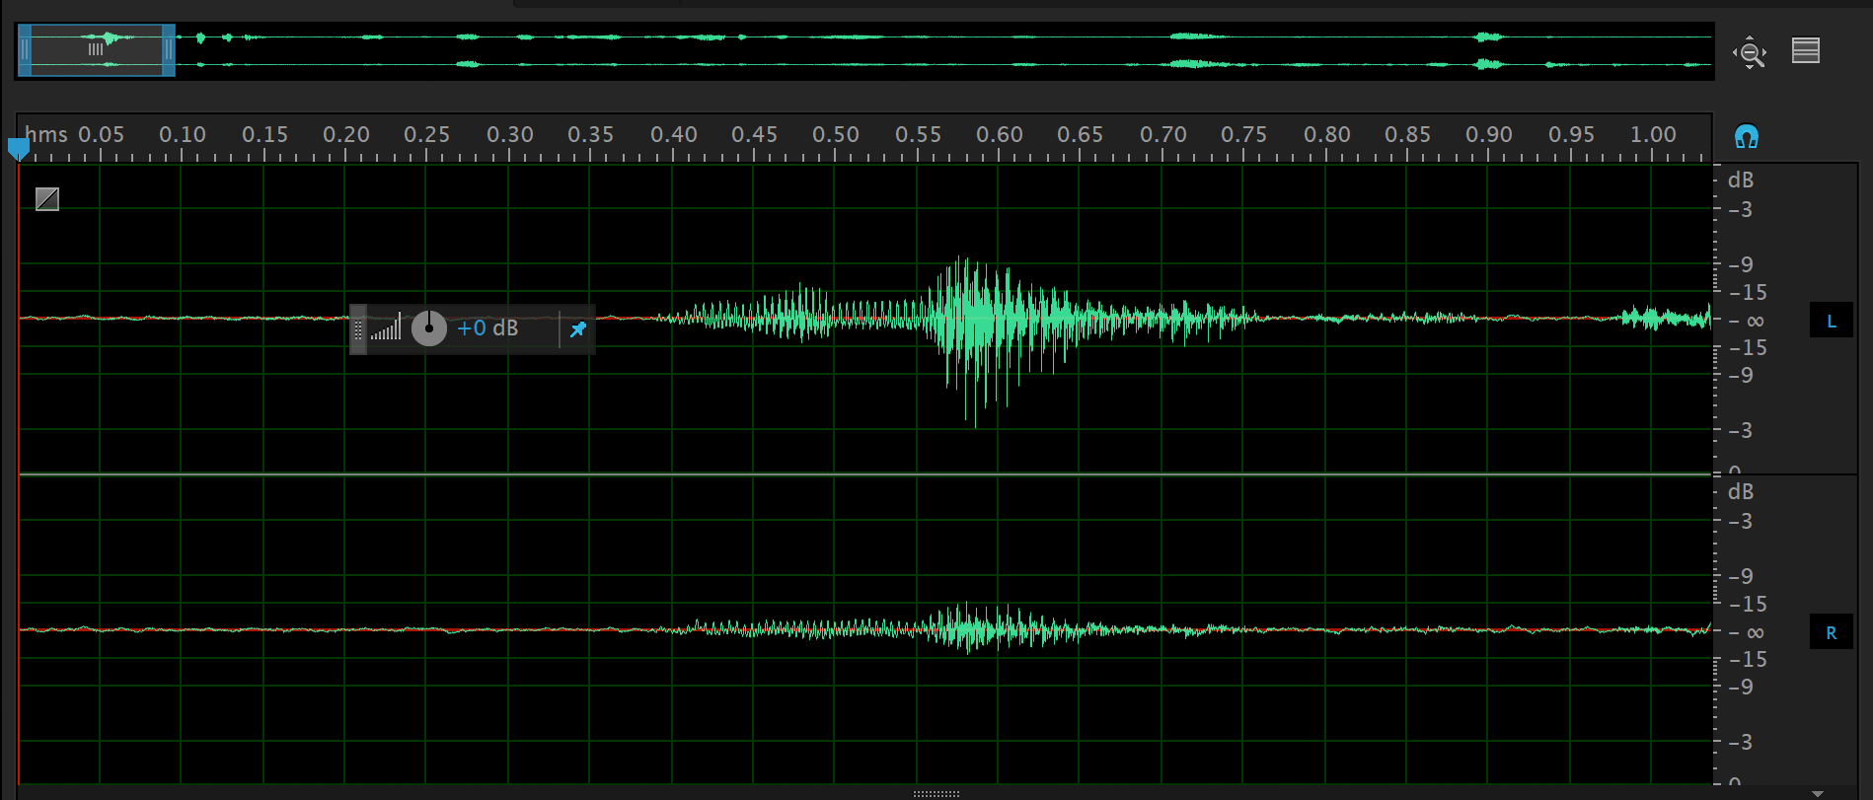
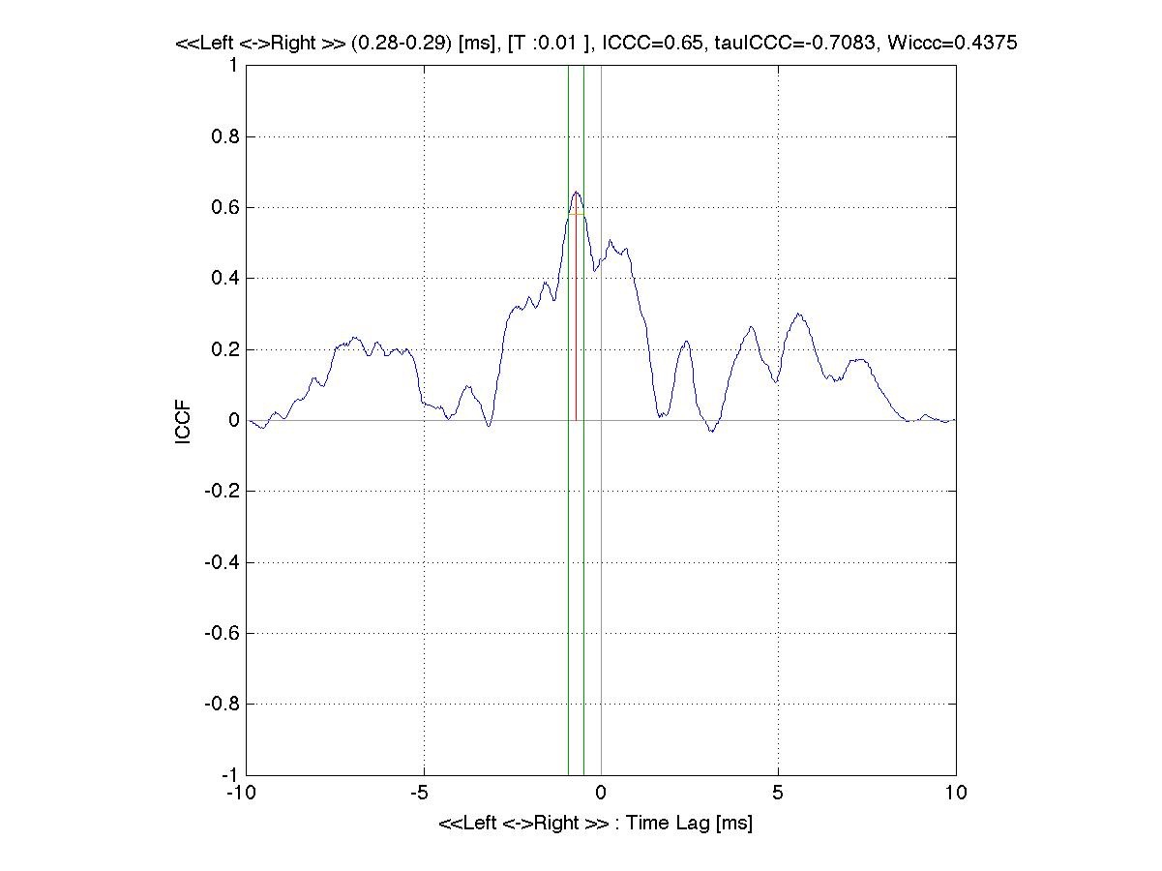
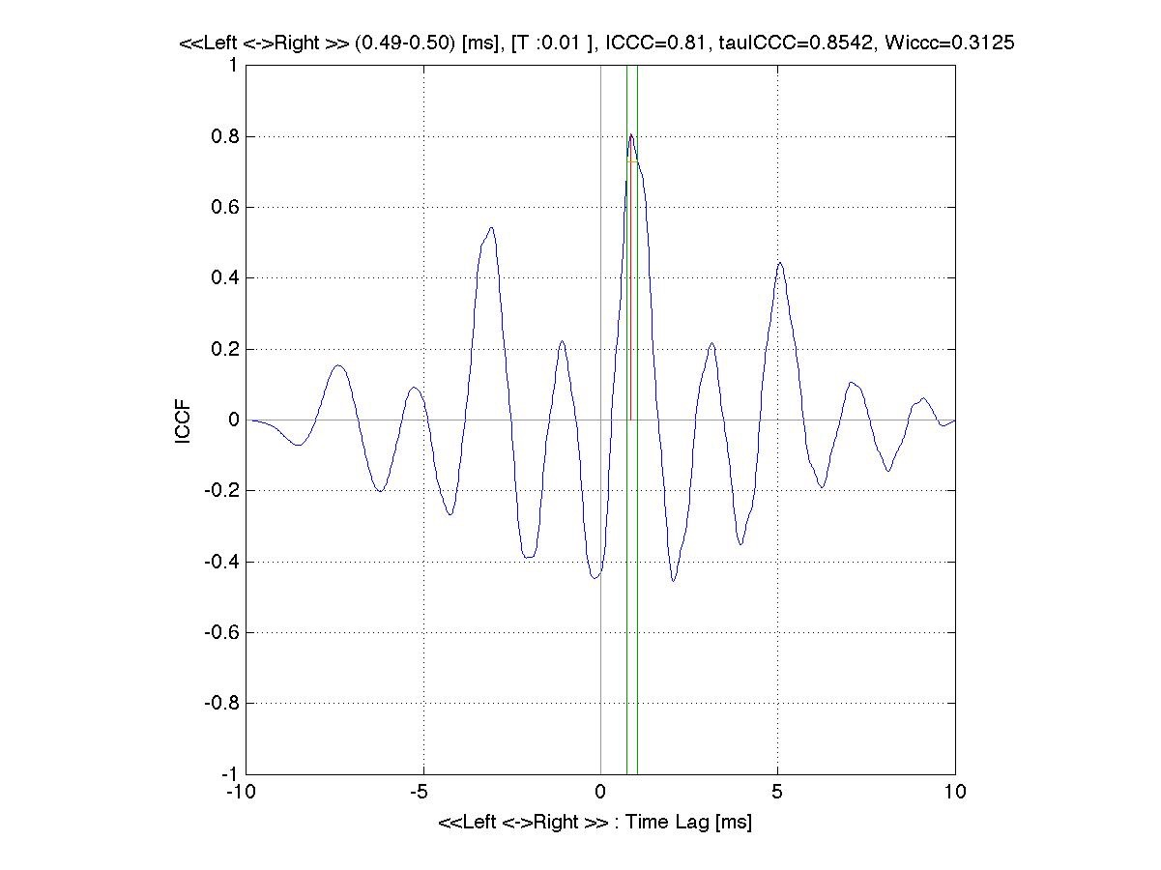
Inter-Channel Crosscorrelation Functions for each time steps
Left
Right

Slide 11
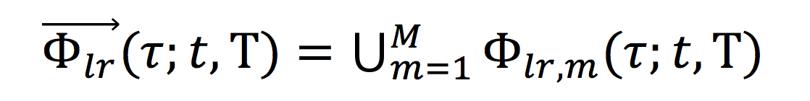
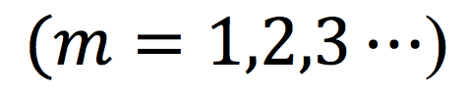
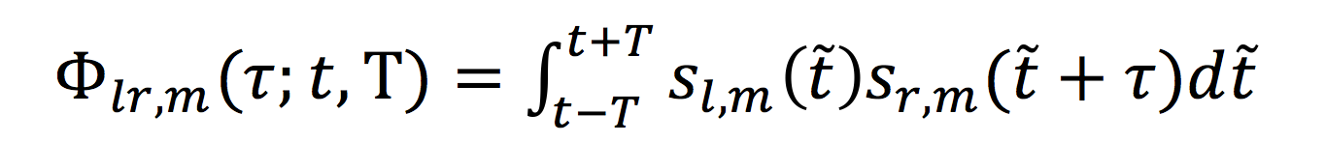
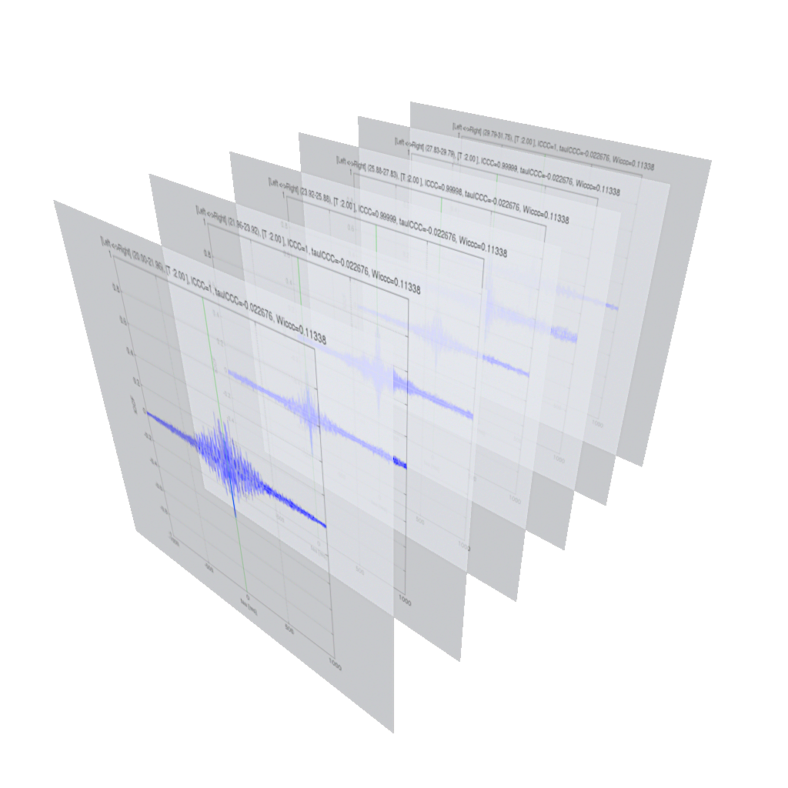




Traveling Inter-Channel Crosscorrelation Function
where
ICCF
Left
T
T
T
T
T
Time (t)
Time Lag (τ)
Right

Slide 12
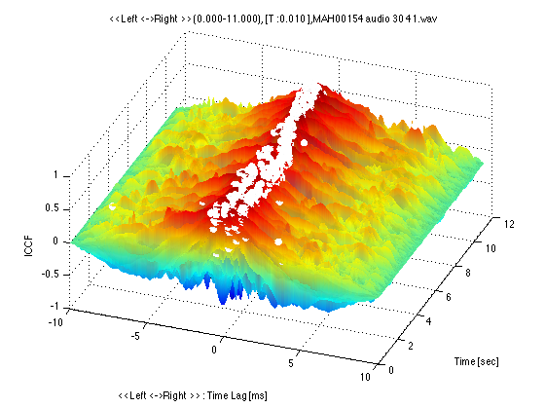
Traveling Inter-Channel Crosscorrelation Function
Left
Right
ICCF (#)
Time (sec)
Time Lag (sec)

Slide 13
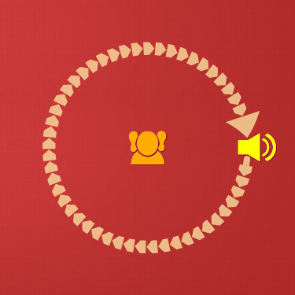
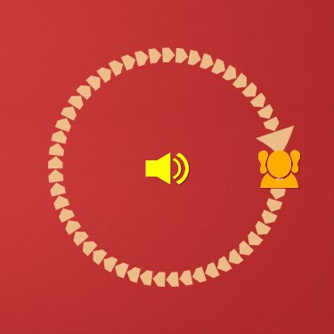
Traveling Inter-Channel Crosscorrelation Analysis for “stereo sounds on the street environment”
(Ambient Listening)
The Speaker is going around the Listener
The Listener is going around the Speaker

Slide 14

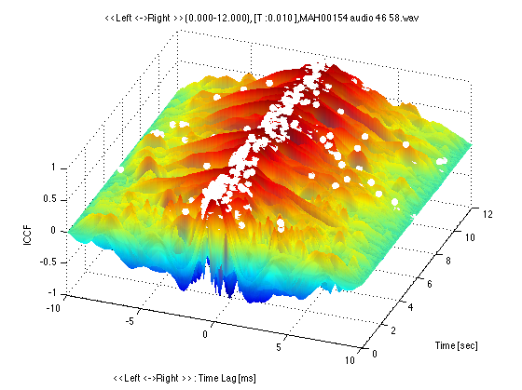
Traveling Inter-Channel Crosscorrelation Analysis for “stereo sounds on the street environment”
(Environmental Sounds)
The Speaker is going around the Listener
The Listener is going around the Speaker
T = 10 (ms)
T = 10 (ms)

Slide 15
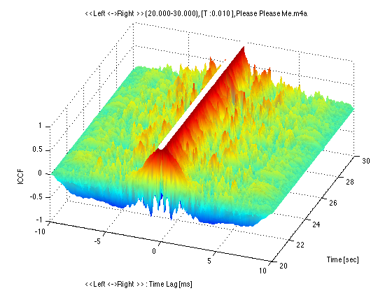
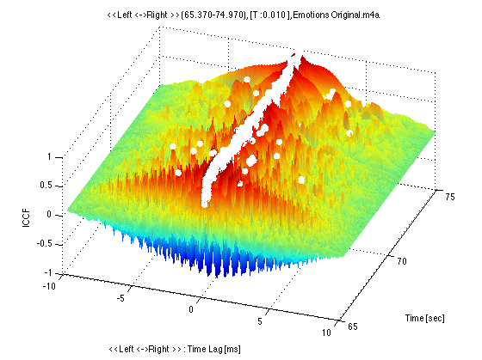
Traveling Inter-Channel Crosscorrelation Analysis for “stereo sounds on the popular music”
(Recorded Contents)
The Beatles, “Please Please Me”
Mariah Carey, “Emotions”
T = 10 (ms)
T = 10 (ms)

Slide 16
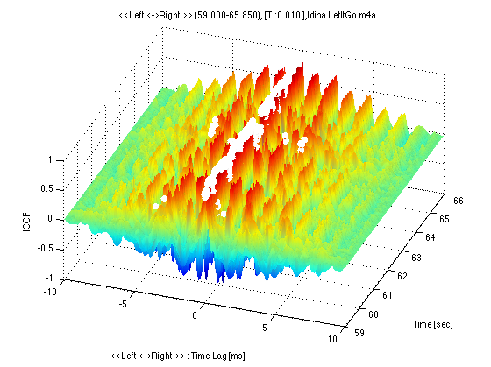
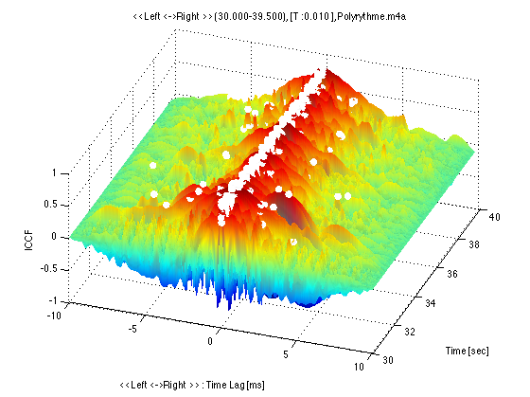
Traveling Inter-Channel Crosscorrelation Analysis for “stereo sounds on the popular music”
(Recorded Contents)
Idina Menzel, “Let It Go”
Perfume, “Polyrhythm”
T = 10 (ms)
T = 10 (ms)

Slide 17
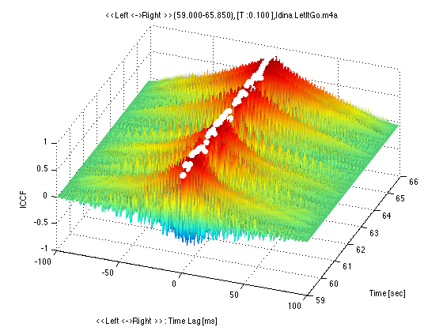
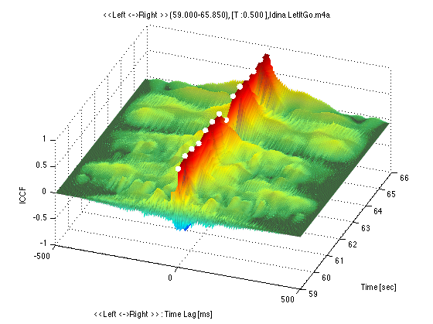
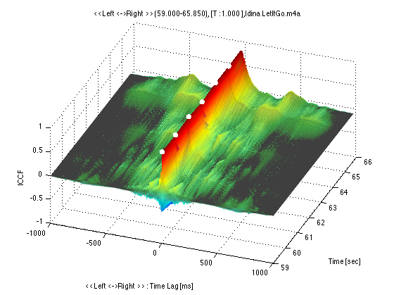
Different Time Scales Comparison
Idina Menzel, “Let It Go”
T = 10 (ms)
T = 100 (ms)
T = 500 (ms)
T = 1000 (ms)

Slide 18
Comparison
“virtual sound-field presented by the recorded content”
“real sound-field to be heard”
The Speaker is going around the Listener
Idina Menzel, “Let It Go”
T = 10 (ms)
T = 10 (ms)

Slide 19
Remarks
Listening to environmental sounds and recorded sound contents are very different qualitatively and quantitatively.
Ambulation with mobile audio headset is quite dangerous.

Slide 20
Remarks
Qualitative and quantitative analyses of human auditory organ for cognition are necessary.
Ears are not only for hearing, but also for comprehending our daily living world with vestibular sensations.

Slide 21
New regulations for mobile listening
Countermeasure 1
Laws and regulations or Self‐imposed controls to prohibit the fatal use of mobile listening devices.
Measurement Indexes by different Places, Climates, Time Periods, Situations and Conditions in ambulation etc. should be developed.

Slide 22
The Importance of Ambient Listening
Countermeasure 2
Human beings sense perception of space with auditory organs. The separation between “virtual sound-field” (e.g. recorded sound contents) and “real sound-field” (e.g. daily-life environment) could easily cause accidents.

Slide 23
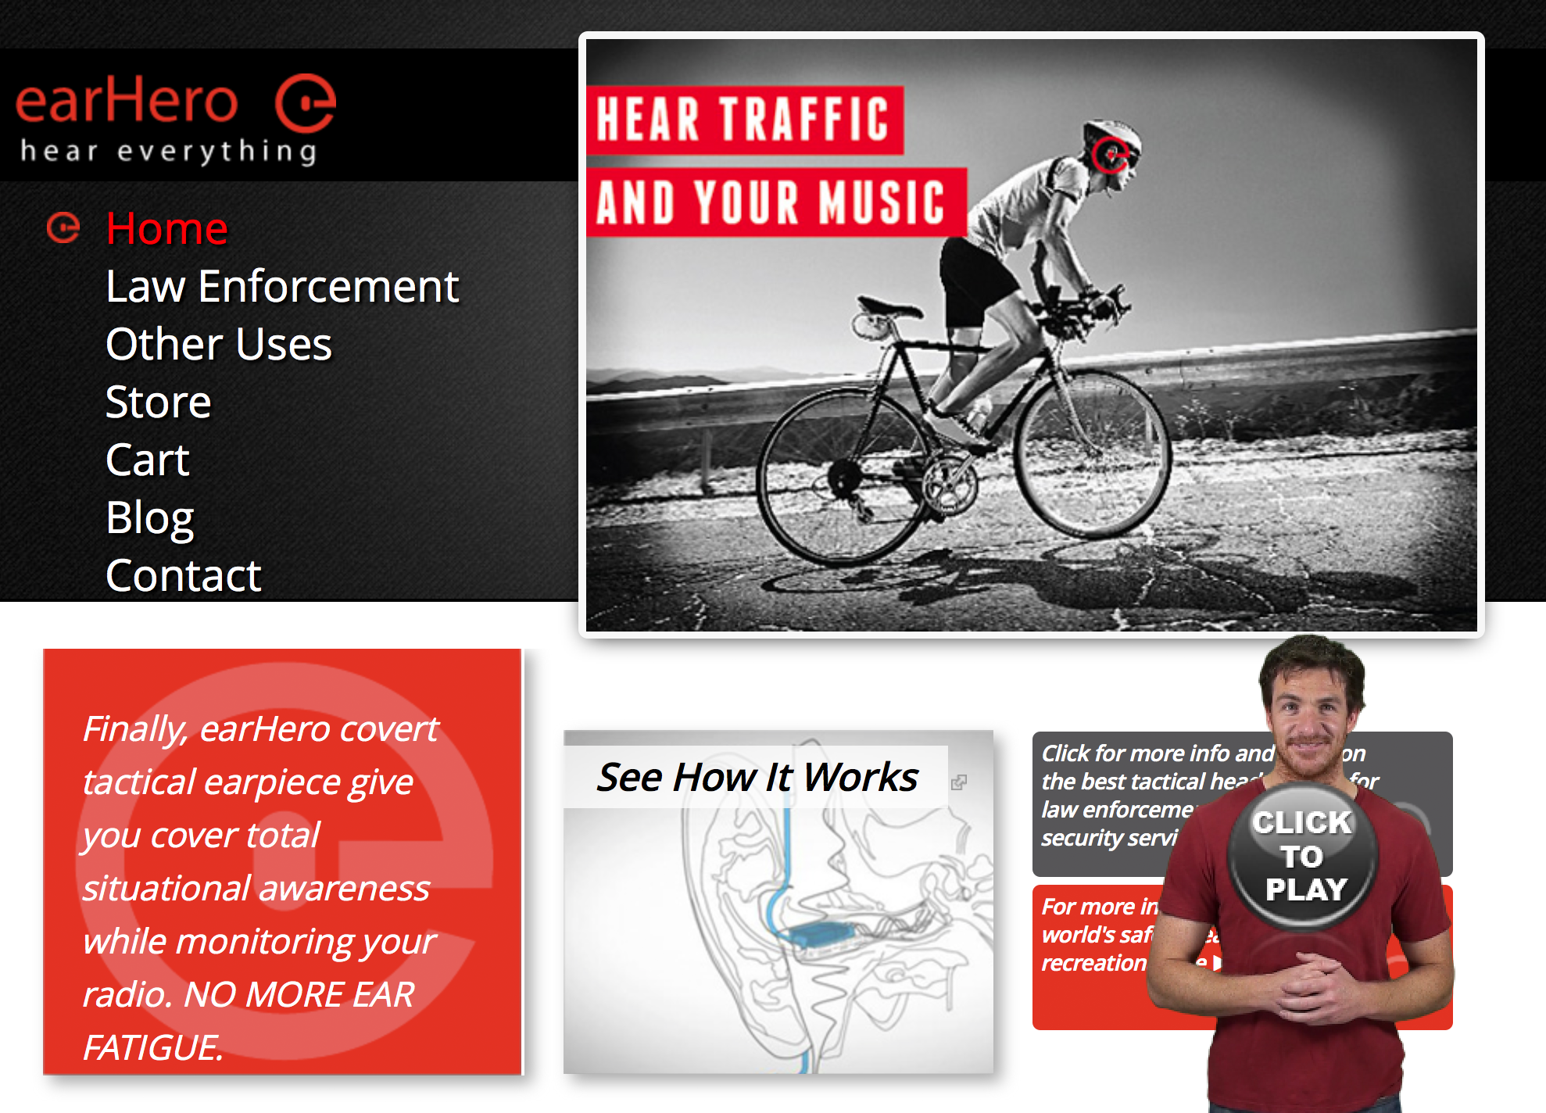
The Importance of Ambient Listening
Countermeasure 2
If we can convolute virtual sound-field to real sound-field, the suitable listening experiences would be provided.
e.g. https://earhero.com

Slide 24
Technical Innovations
Countermeasure 3
In Japan, problems of sound leak in public transport is quite notorious. Therefore encapsulated headphones are preferred.
But encapsulated headphones have decisive risk which we have discussed in this paper.

Slide 25
Technical Innovations
Countermeasure 3
“open-noise-cancelling headphones” by innovation will be preferable.
Implementing limiter or alarm function in headphones for big or urgent sounds by realtime analysis of environmental sounds will reduce the problems.

Slide 26
Thank you for your kind attention. Your questions / comments are always welcome.
Division of Composition and Conducting, Interfaculty Initiative in Information Studies, The University of Tokyo
taiso.renpoo@gmail.com (SATO, Koji)
itosec@iii.u-tokyo.ac.jp (ITO, Ken)

